Slide 1

AI/ML Bootcamp 2023
school.wakehealth.edu/wfbmi @WFBMI

Slide 2

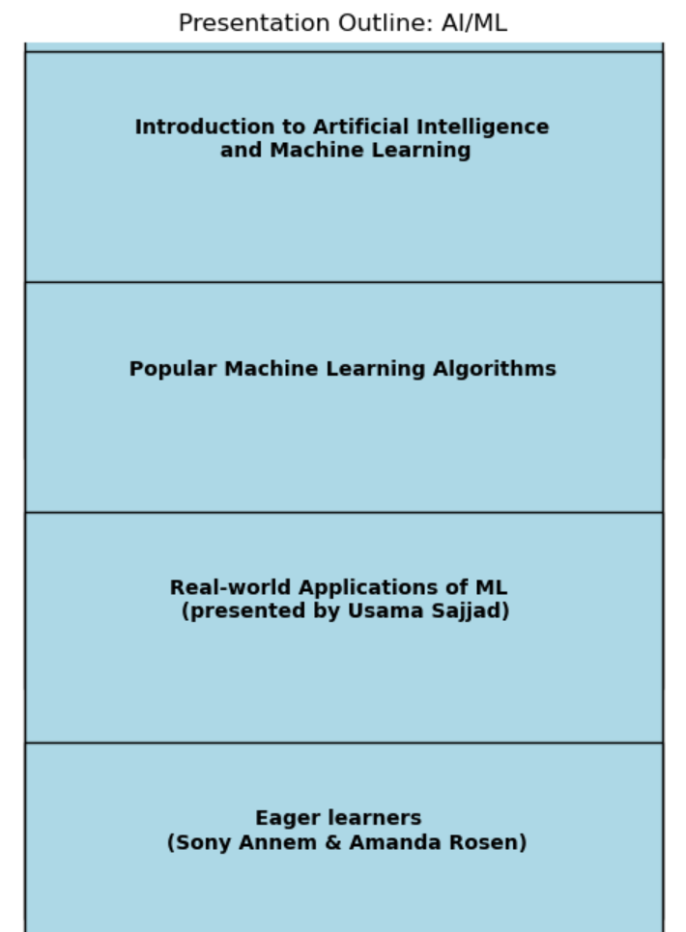
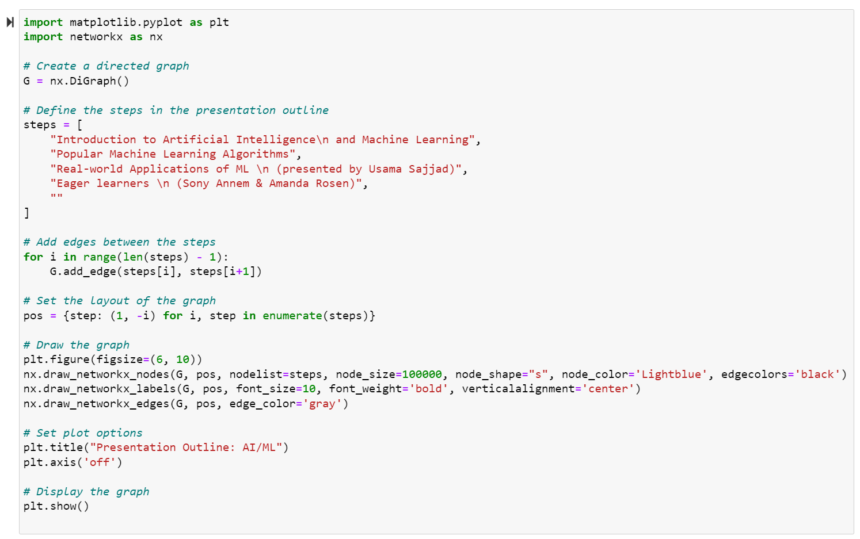
Outline:

Slide 3
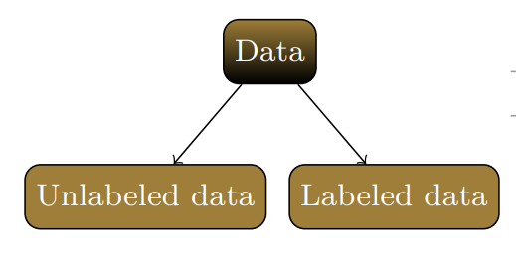
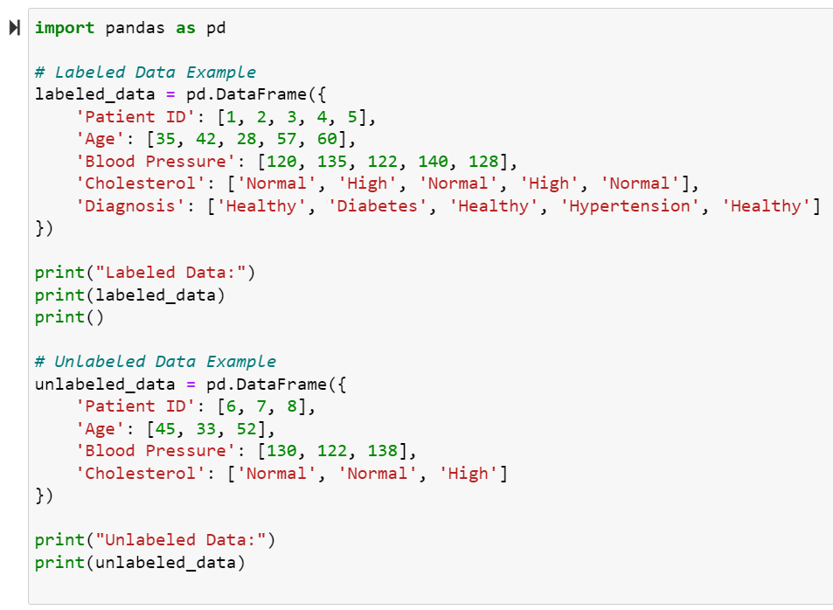
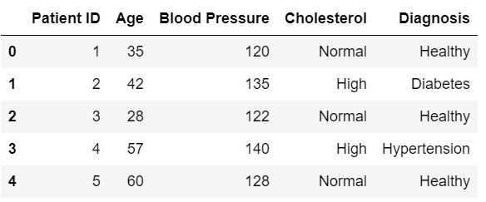
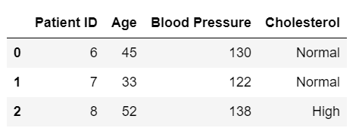
Labeled vs Unlabeled Data:

Slide 4
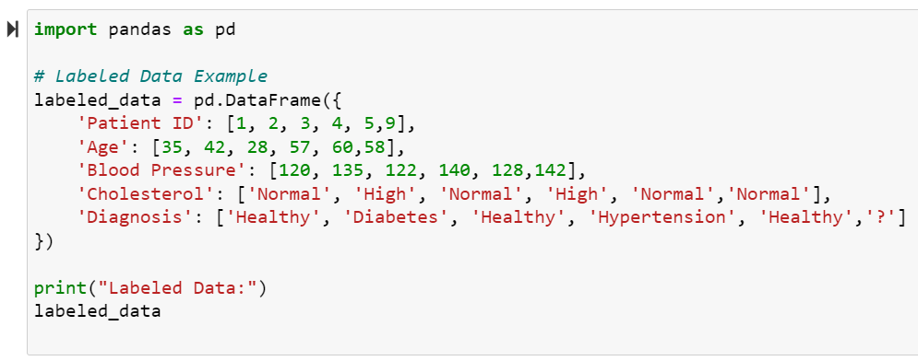
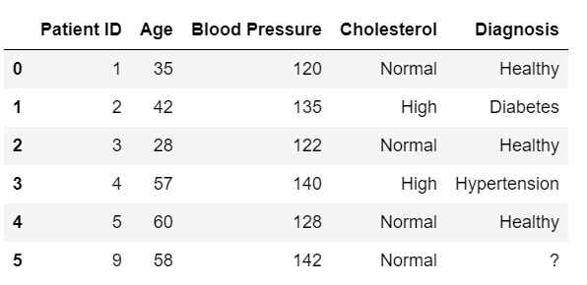
Labeled vs Unlabeled Data:

Slide 5
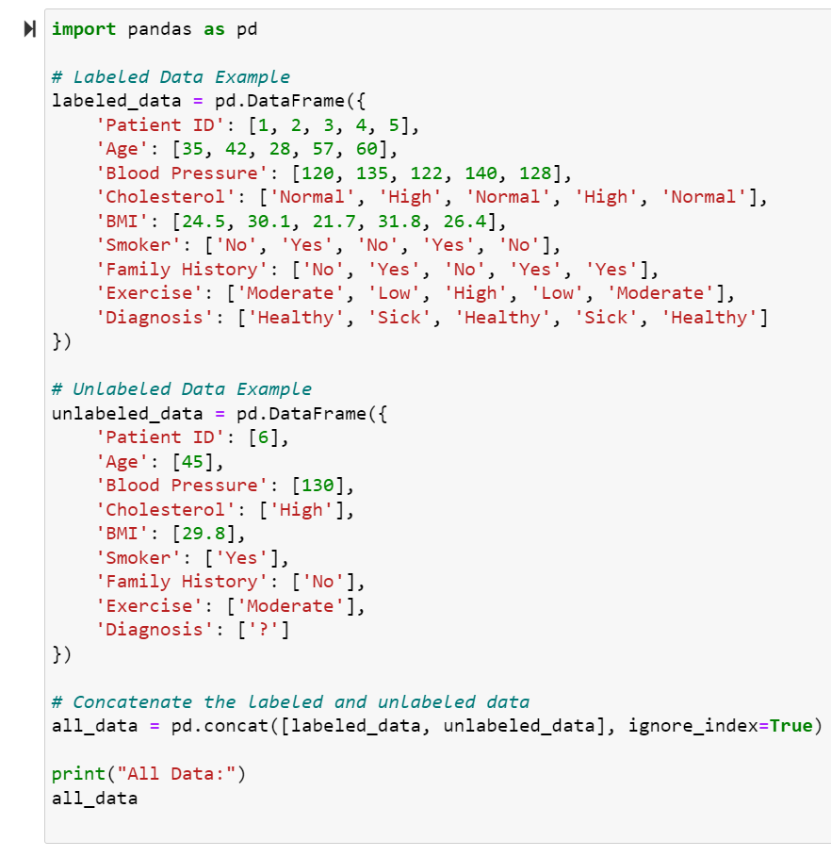
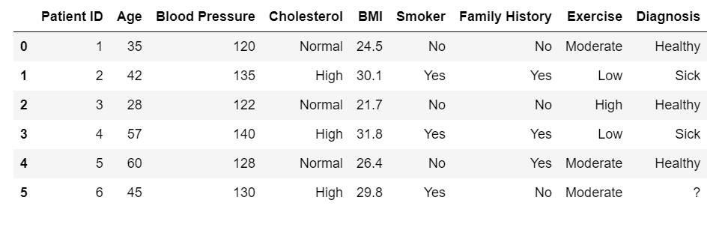

Slide 6
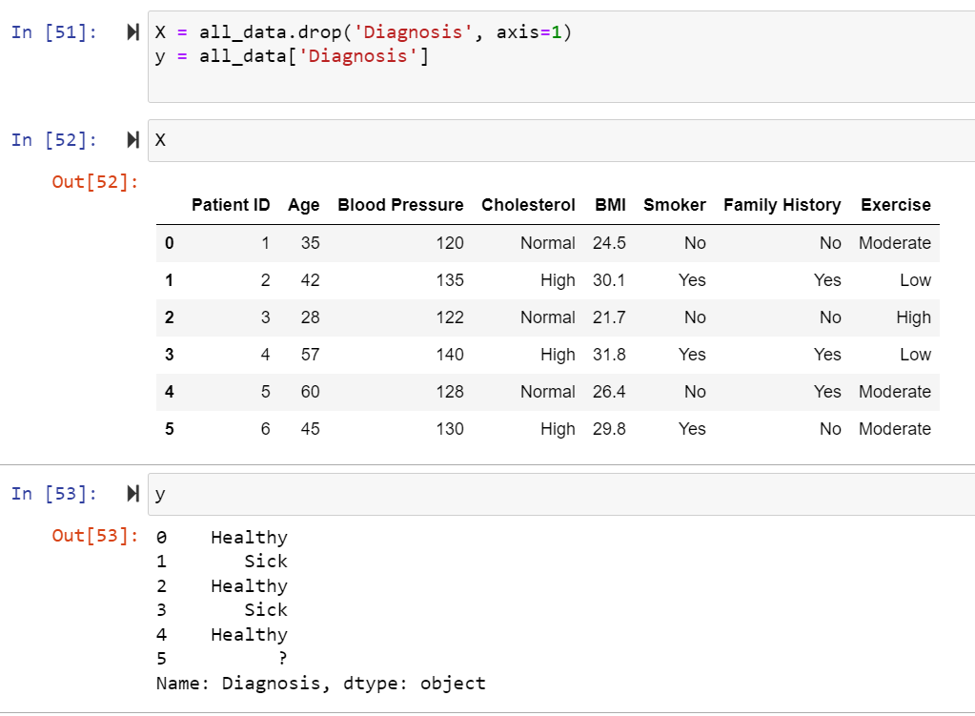
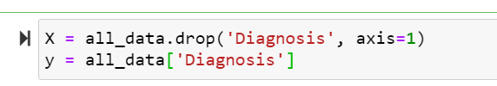
Split the data into features (X) and the target variable (y). In this case, the features will be all the columns except 'Diagnosis', and the target variable will be 'Diagnosis'.

Slide 7
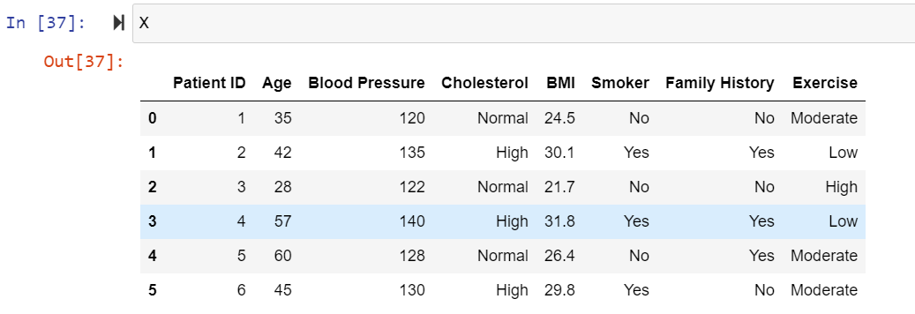
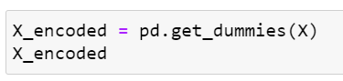
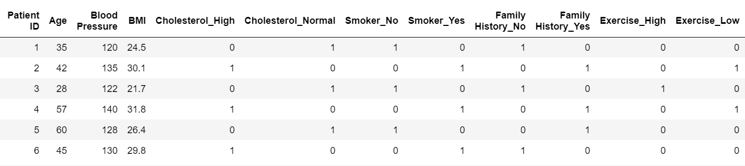
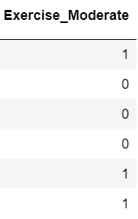
Categorical variables:
Encode categorical variables using one-hot encoding. This step is necessary to convert categorical variables into a numerical format that the machine learning model can understand.

Slide 8
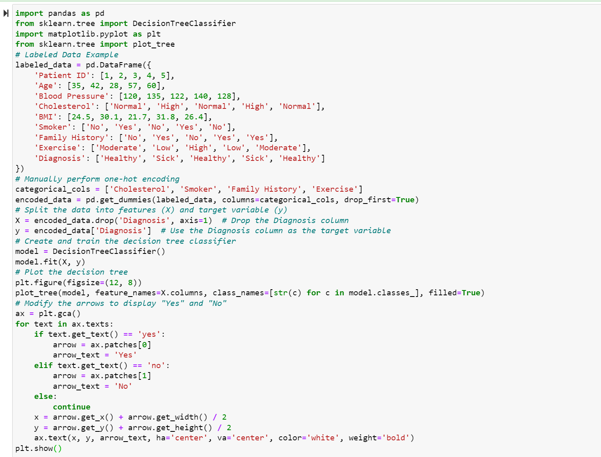
Decision Tree Classifier:

Slide 9
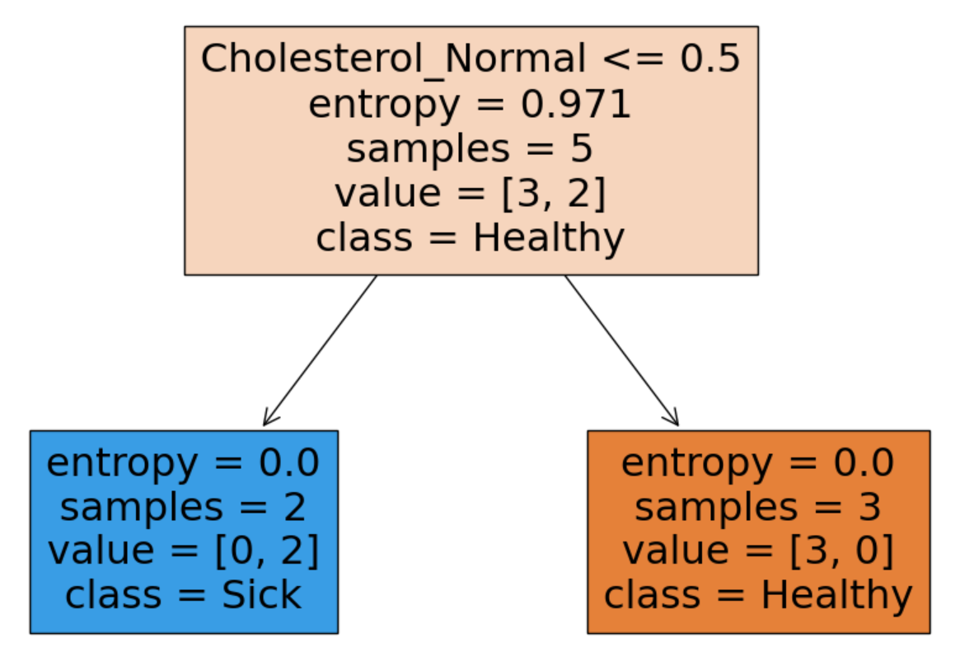
Decision Tree Classifier:

Slide 10
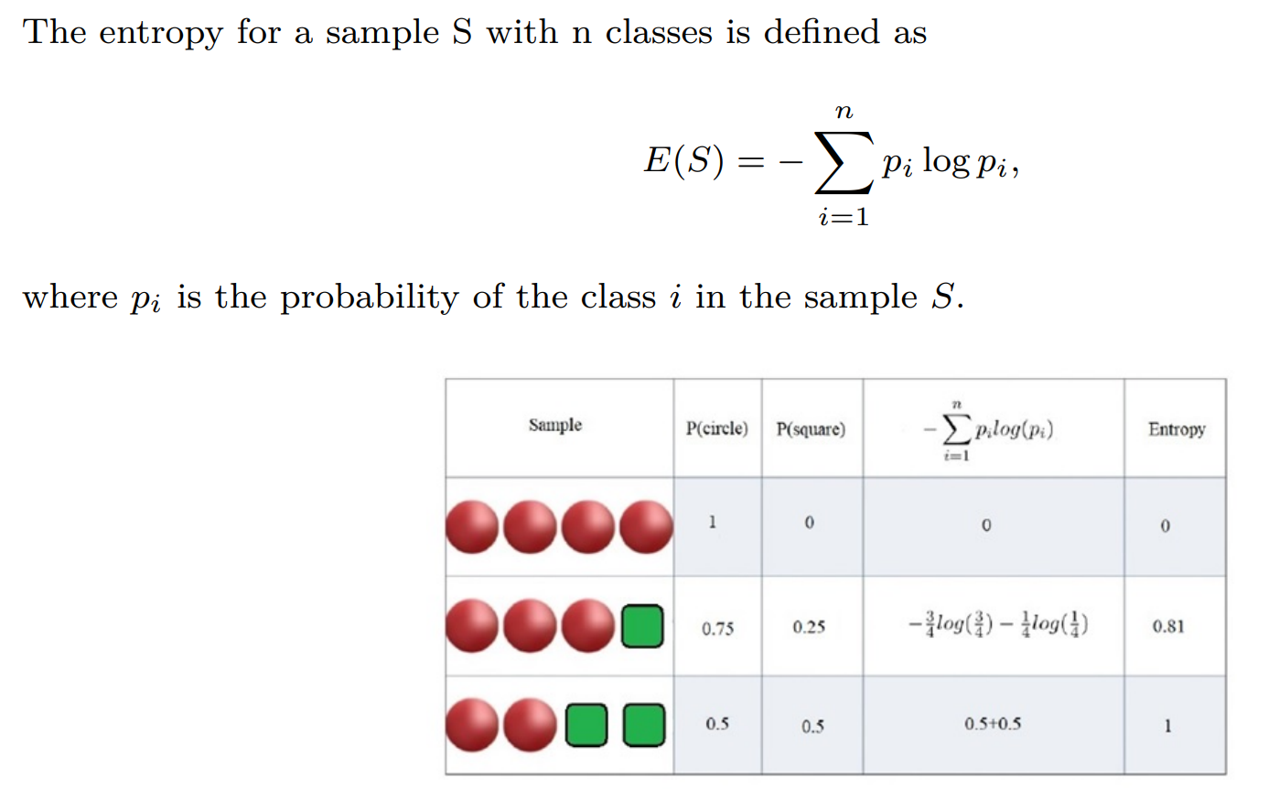
Entropy:

Slide 11
Decision Tree Classifier:

Slide 12
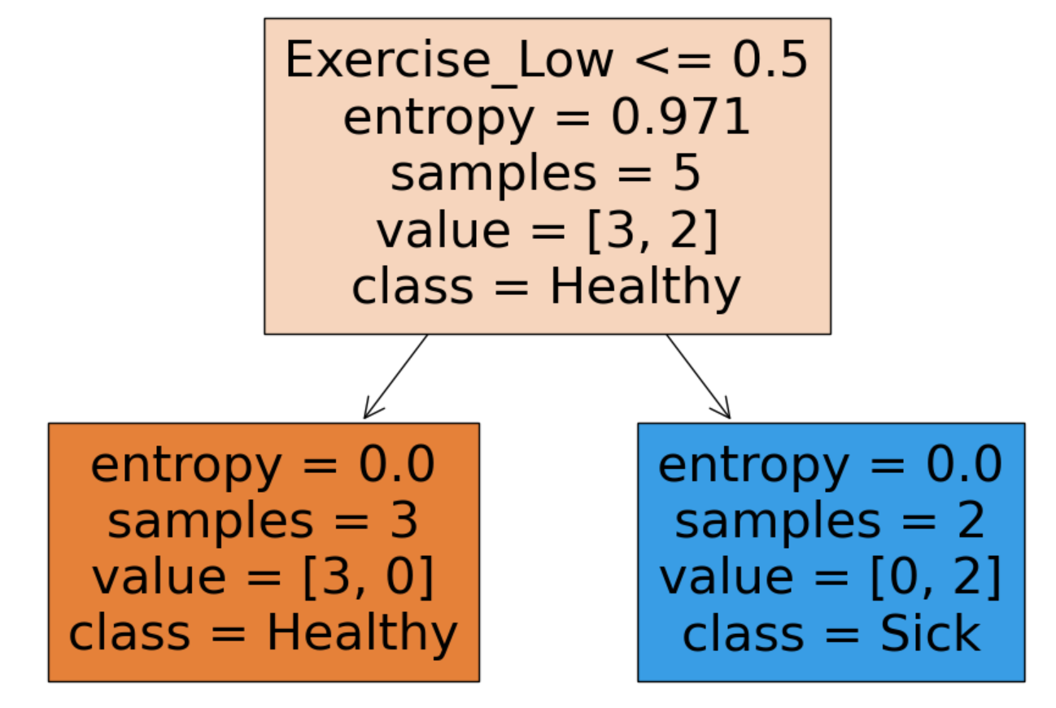
Decision Tree Classifier:

Slide 13
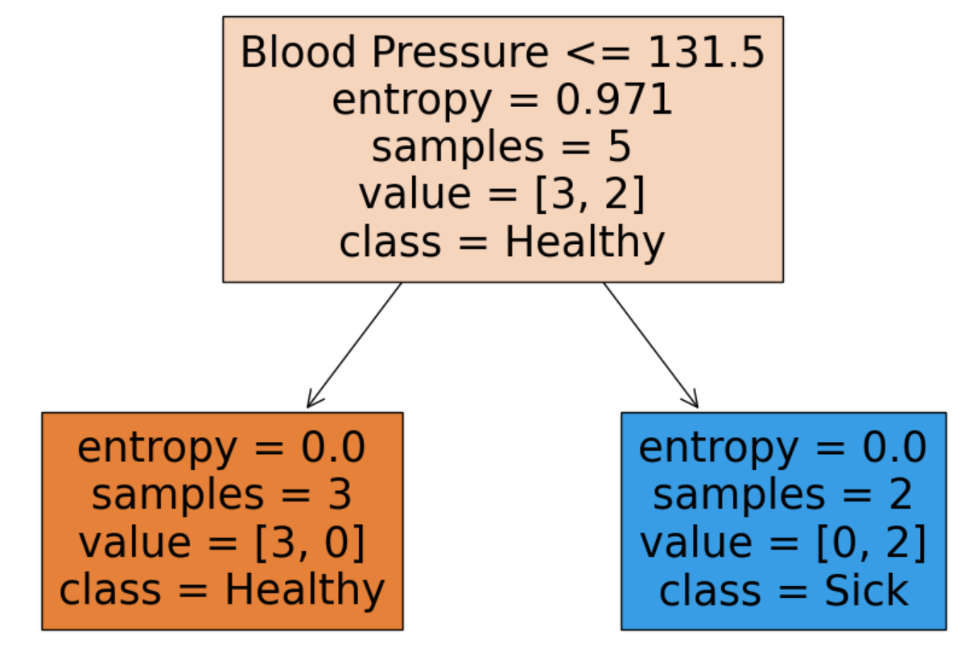
Decision Tree Classifier:

Slide 14
Decision Tree Classifier:
What is your prediction?

Slide 15
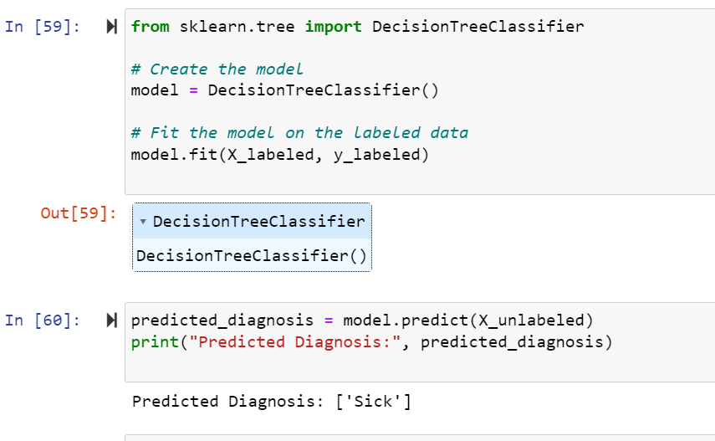
Decision Tree Classifier:

Slide 16
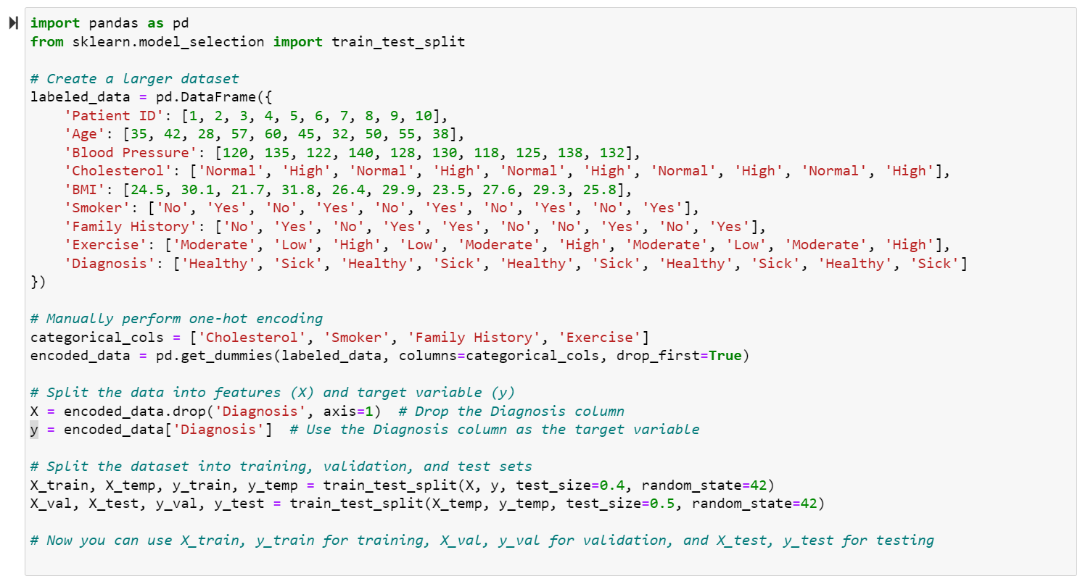
Training-validation-test split:
Example of creating a larger dataset and splitting it into training, validation, and test sets:

Slide 17
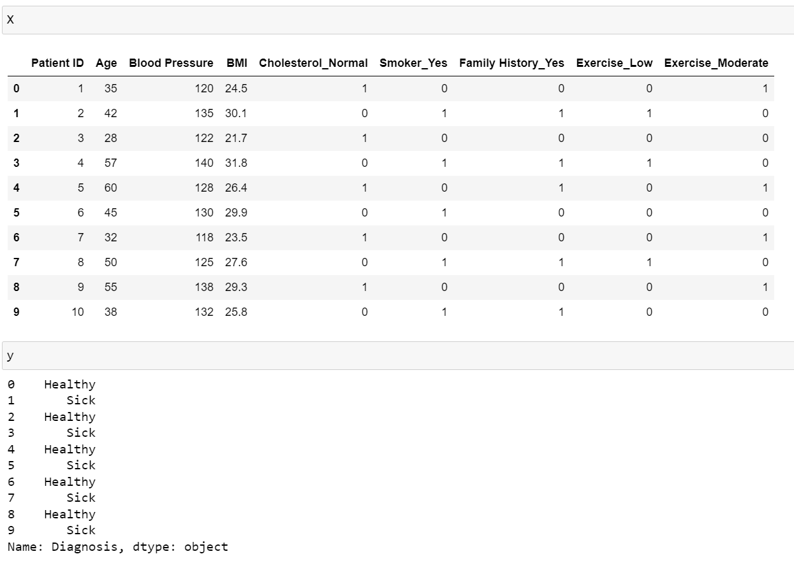
Training-validation-test split:
Example of creating a larger dataset and splitting it into training, validation, and test sets:

Slide 18
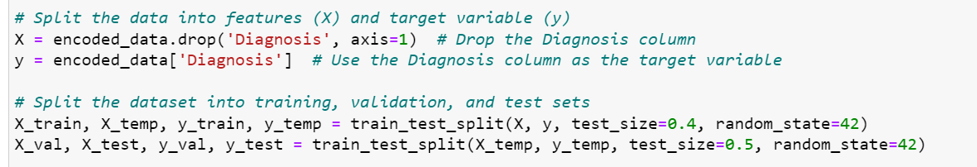
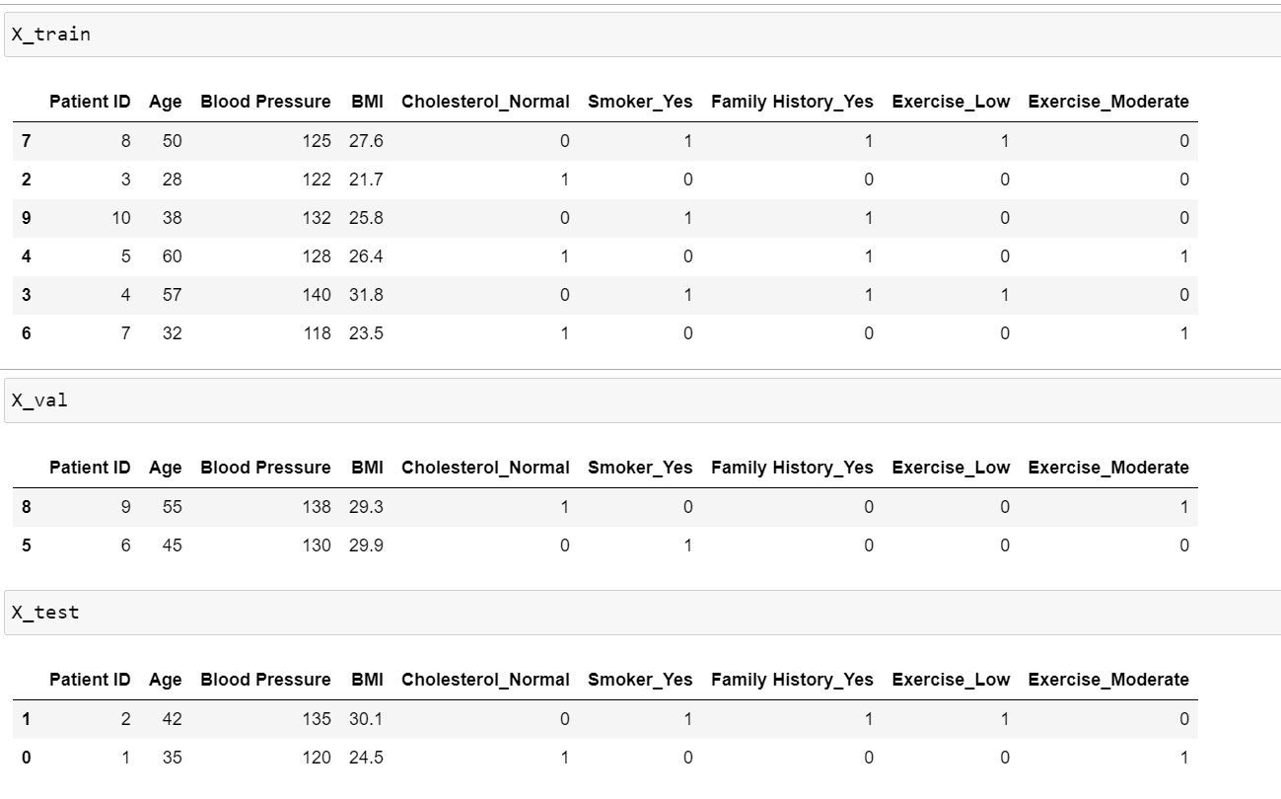
Training-validation-test split:

Slide 19
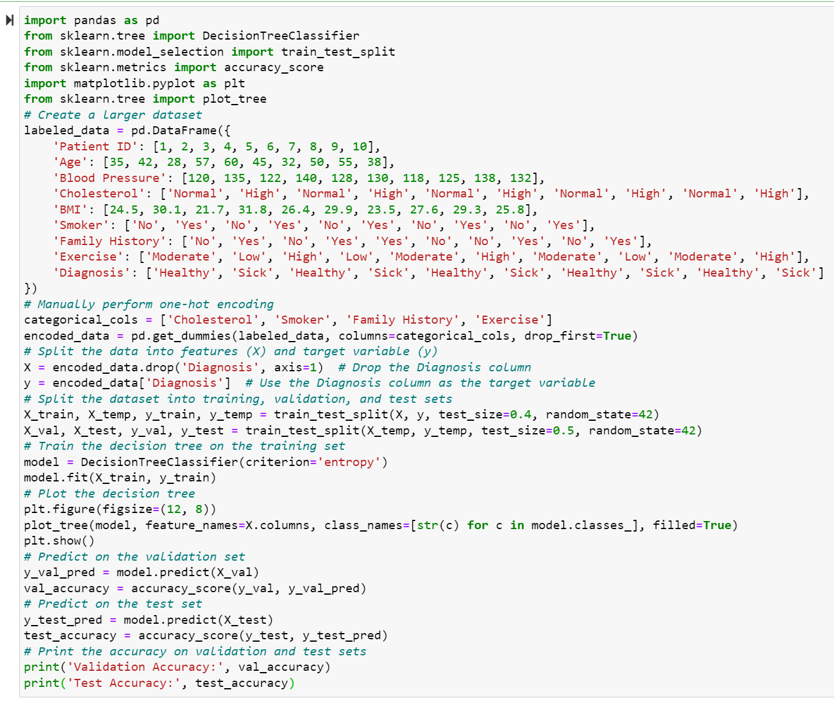
Training-validation-test split- Decision Tree:

Slide 20
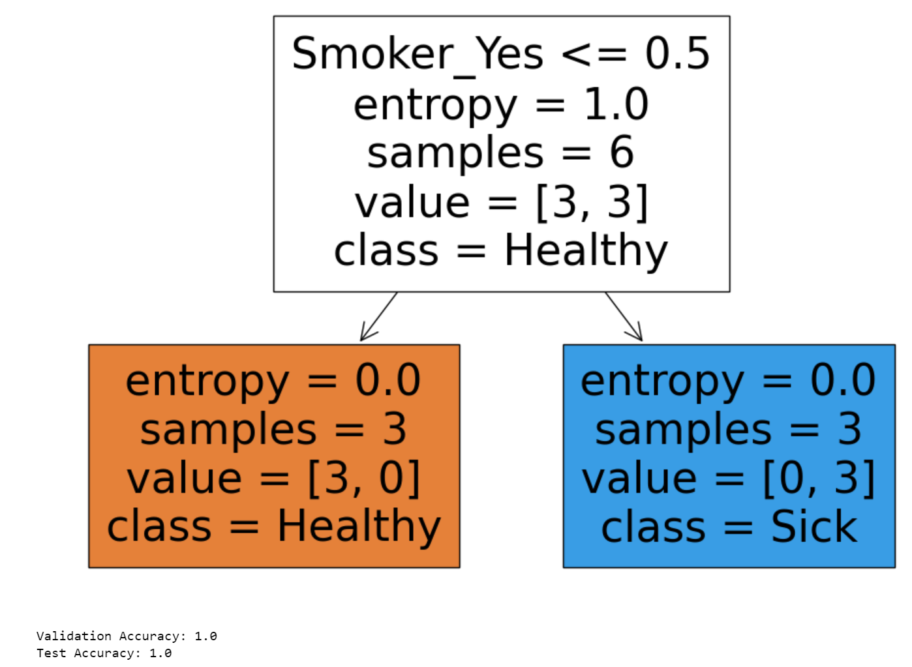
Training-validation-test split- Decision Tree:

Slide 21
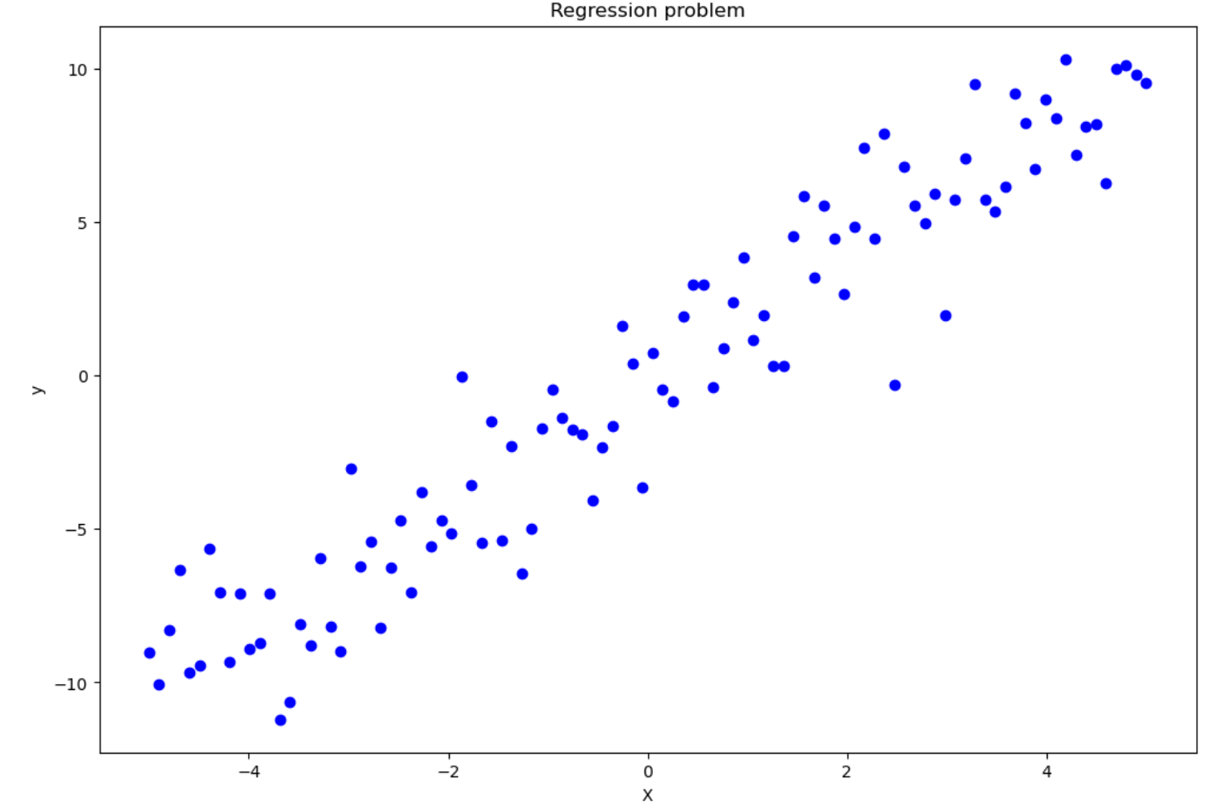
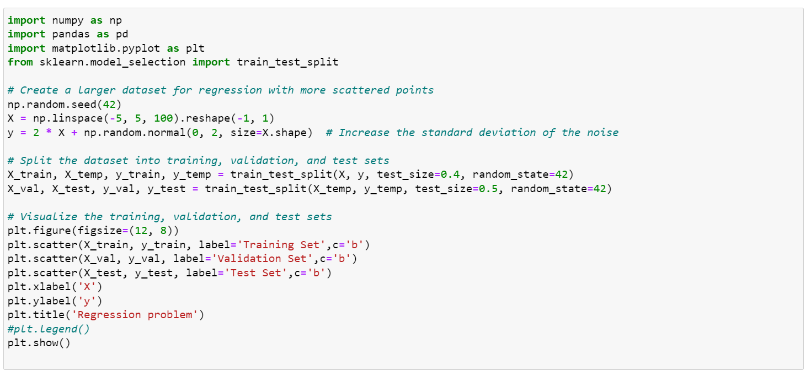
Regression:

Slide 22
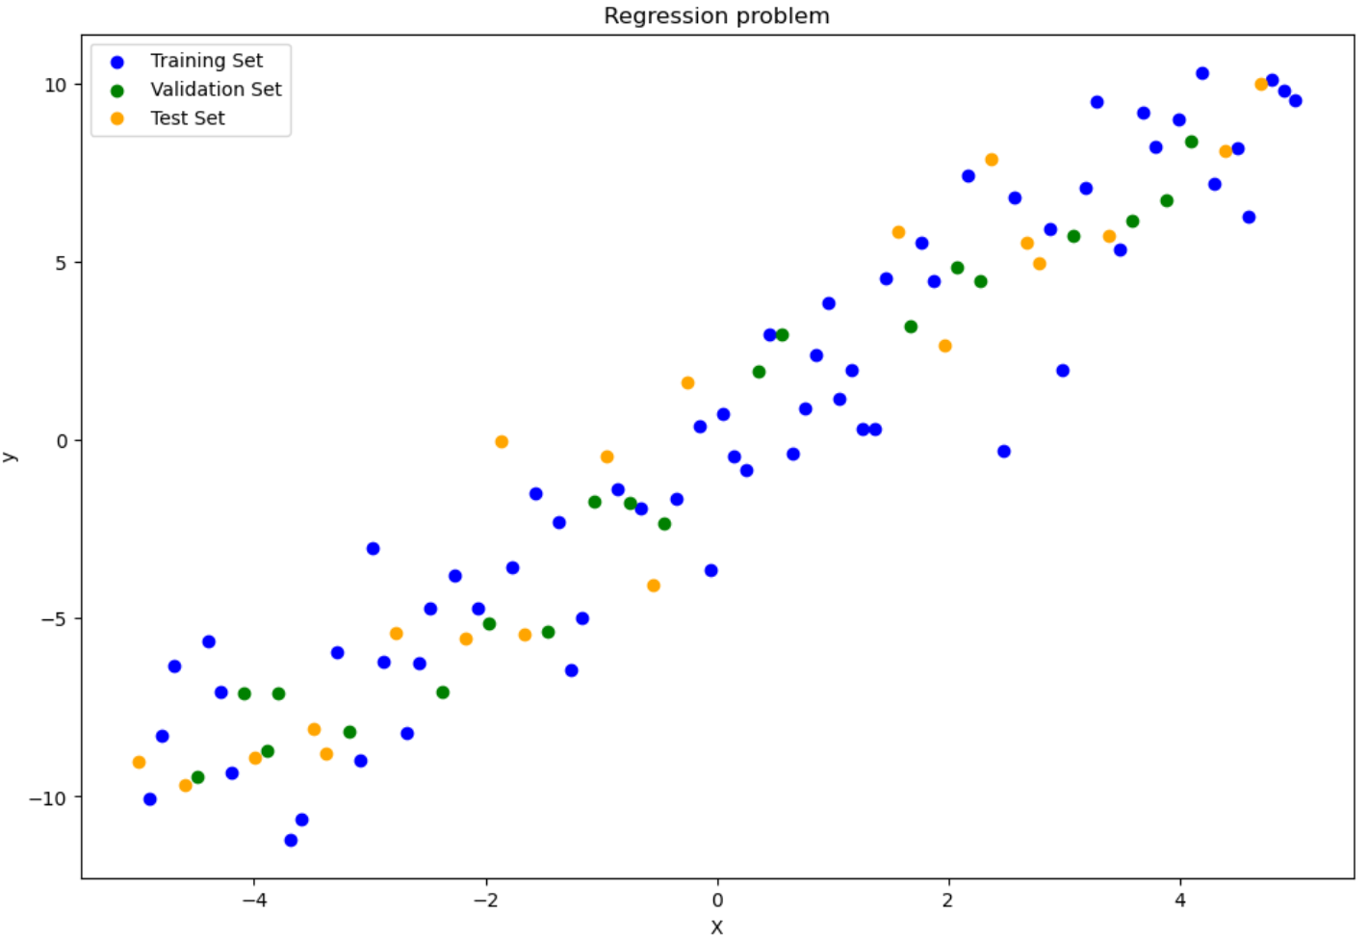
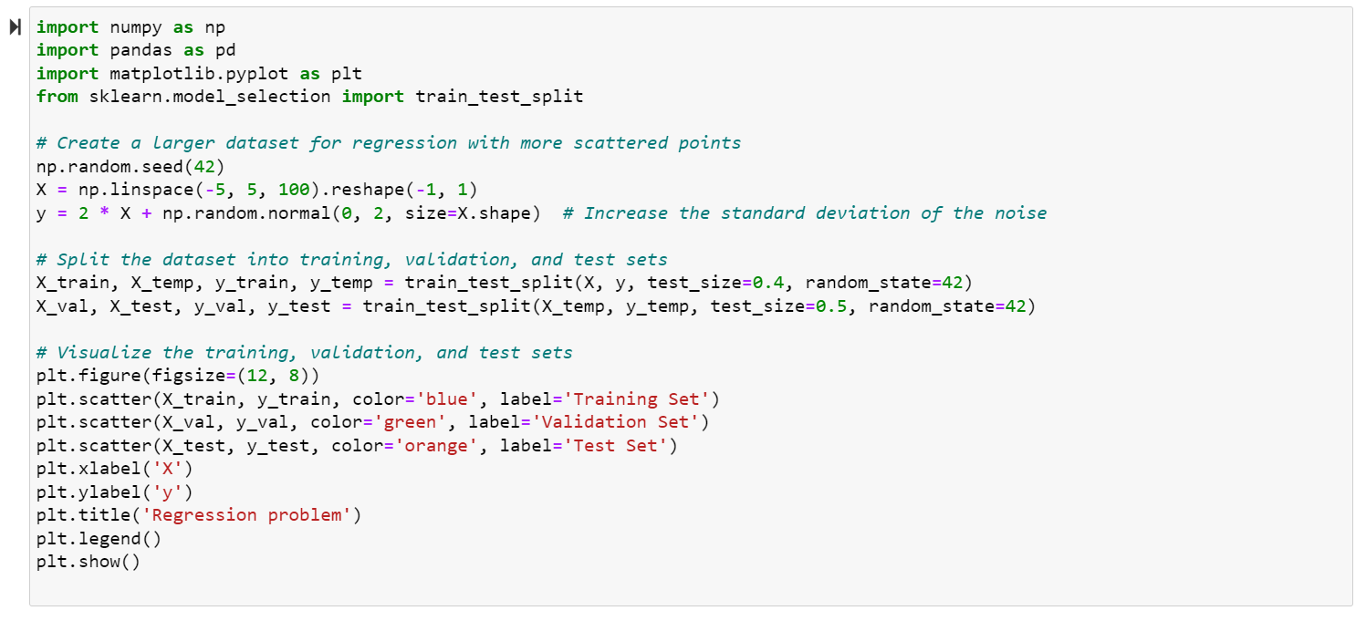
Training-validation-test split- Regression:

Slide 23
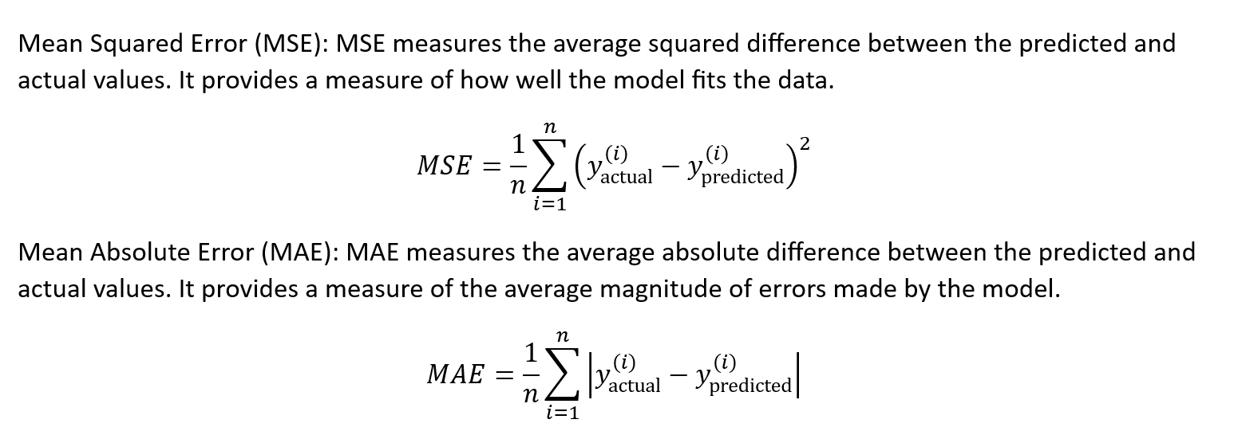
Loss function:

Slide 24
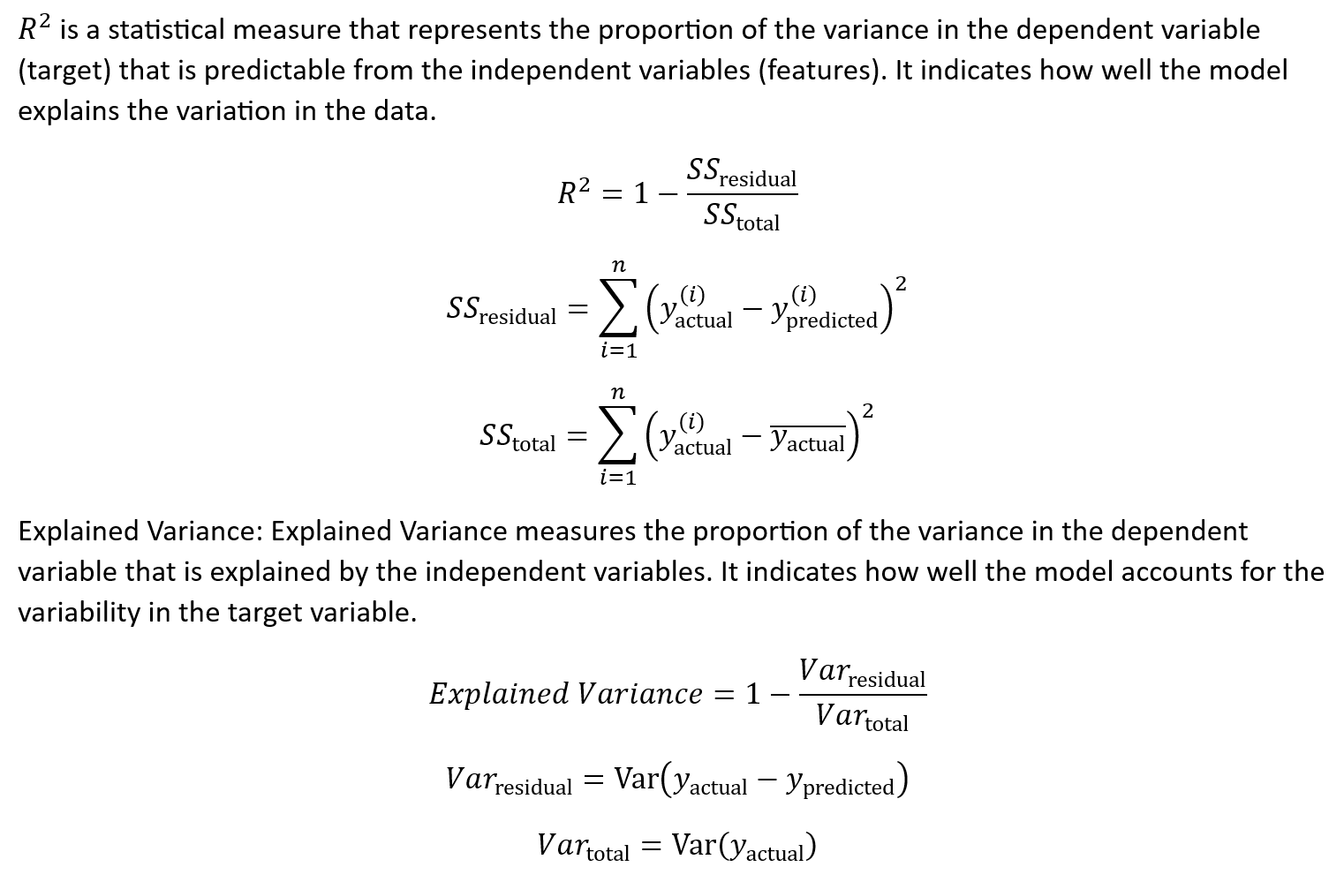
Other metrics:

Slide 25
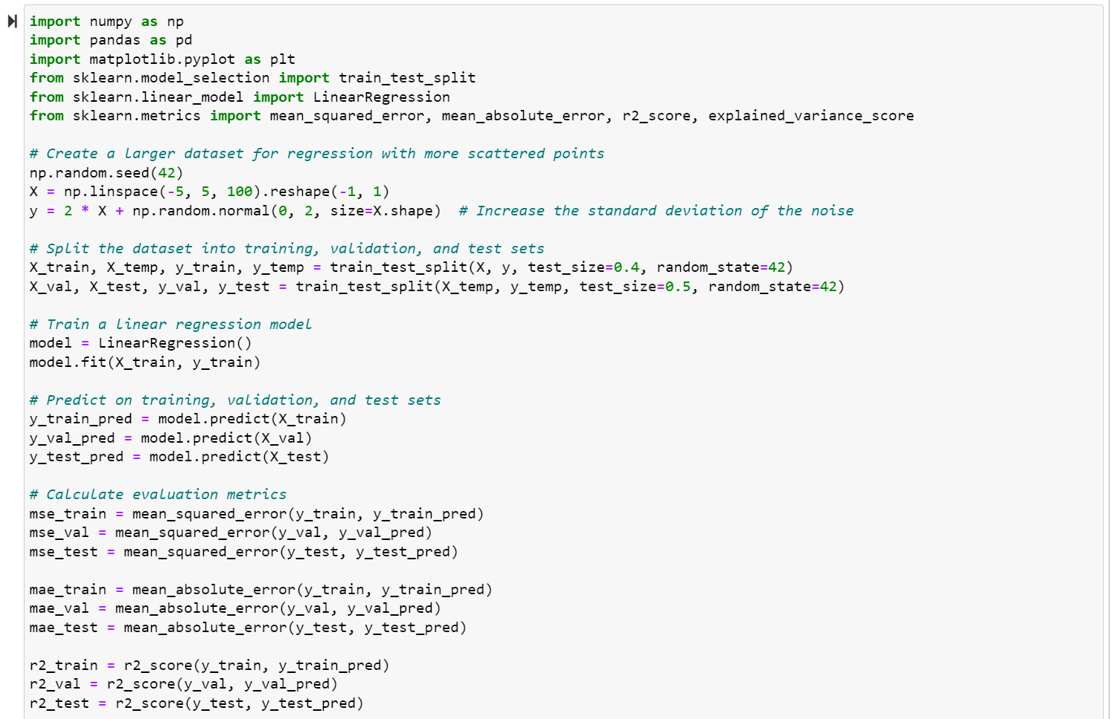
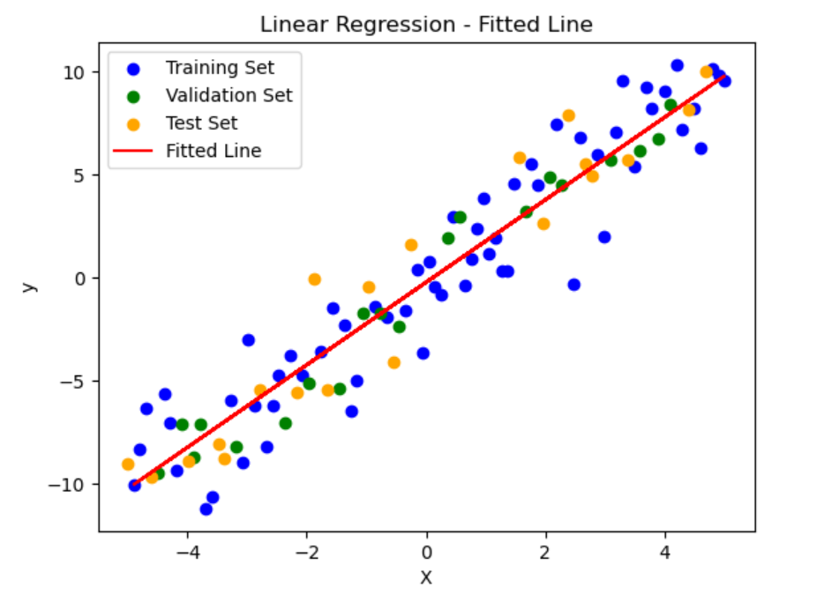
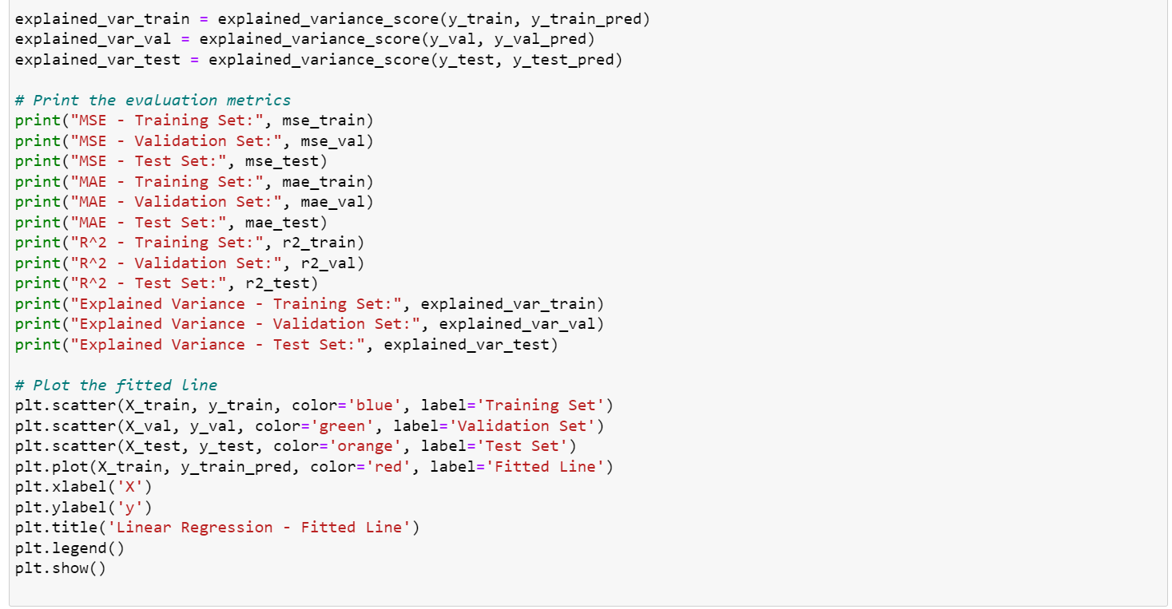
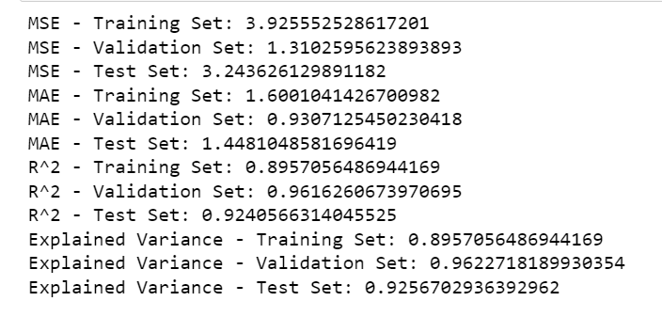

Slide 26
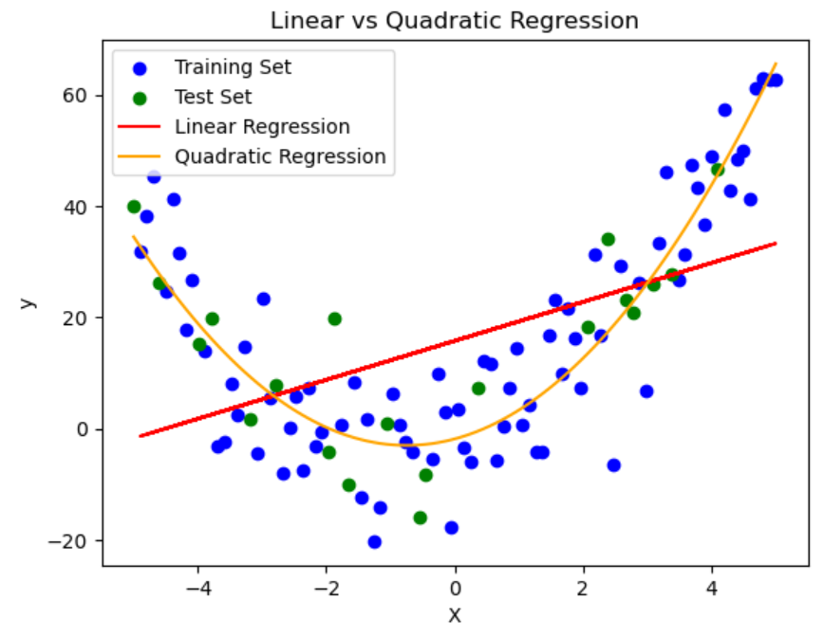
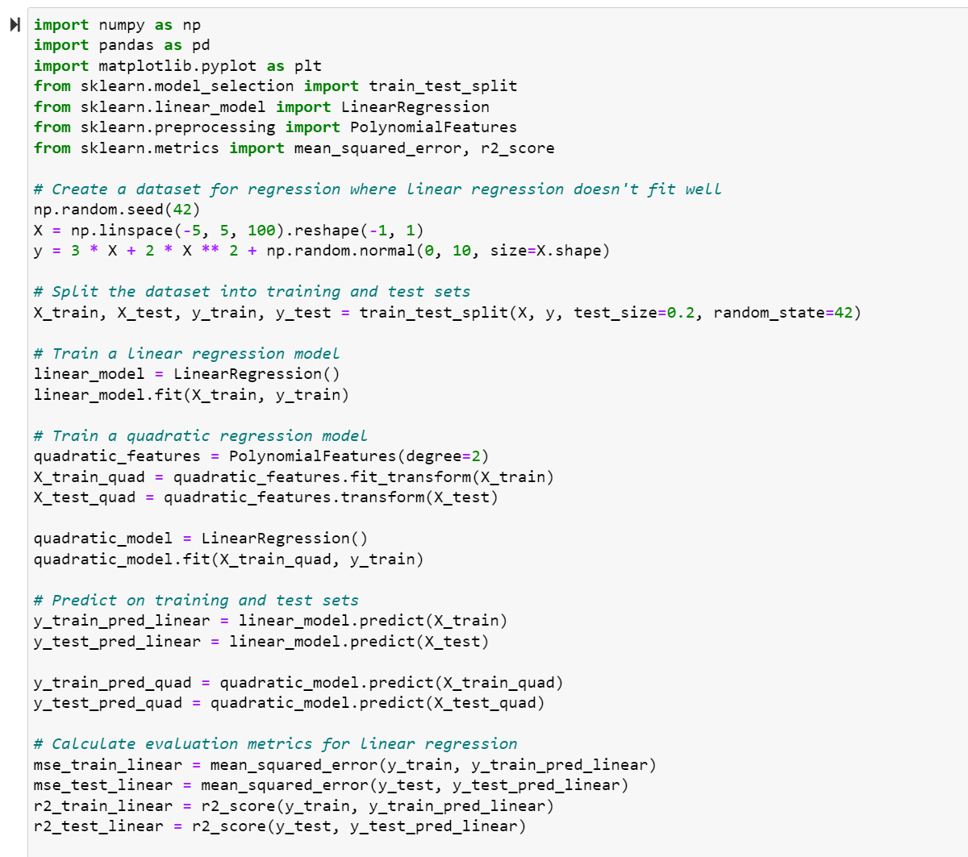
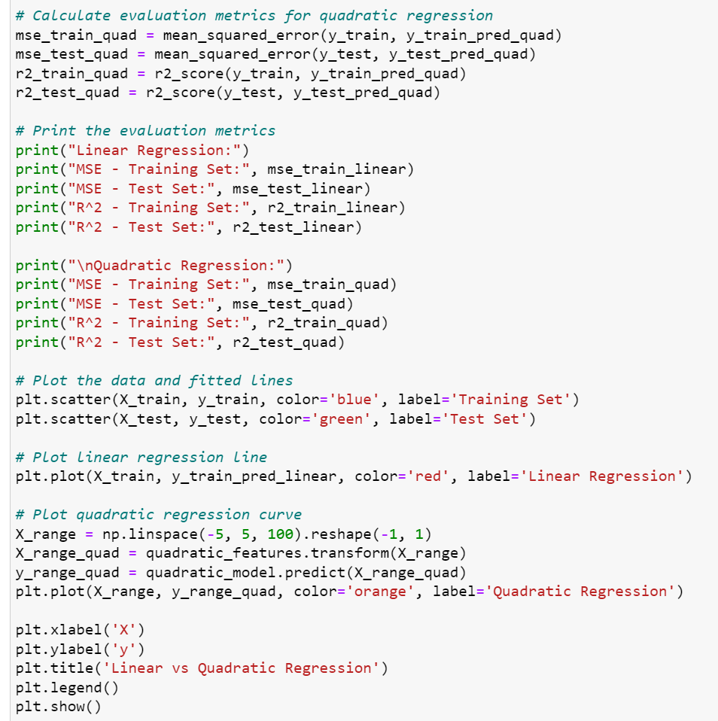
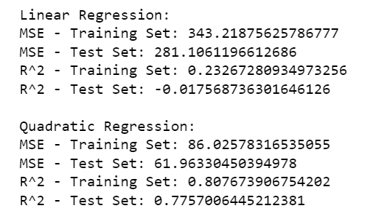

Slide 27
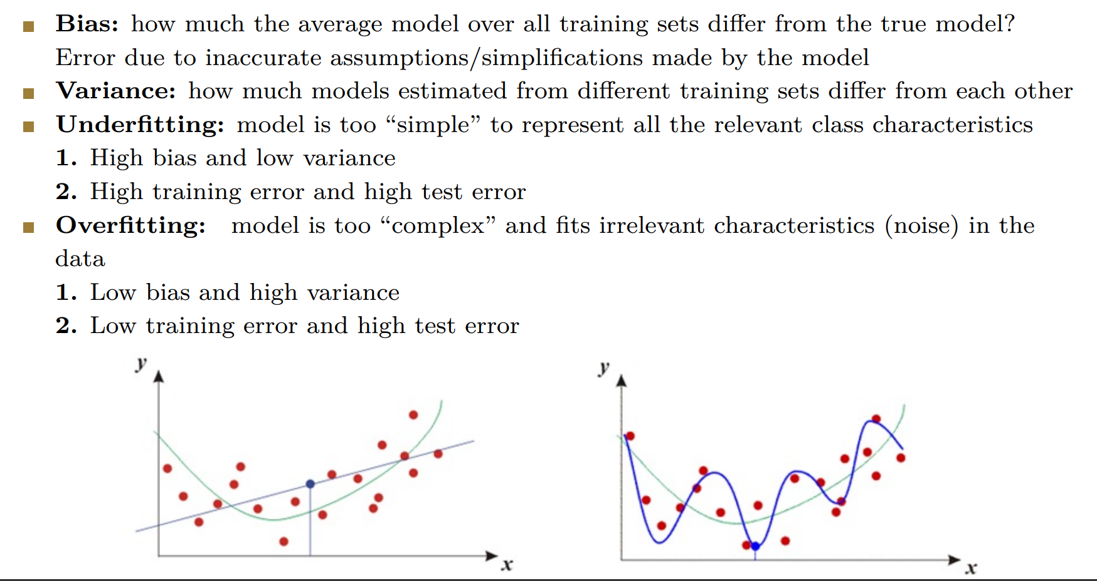

Slide 28
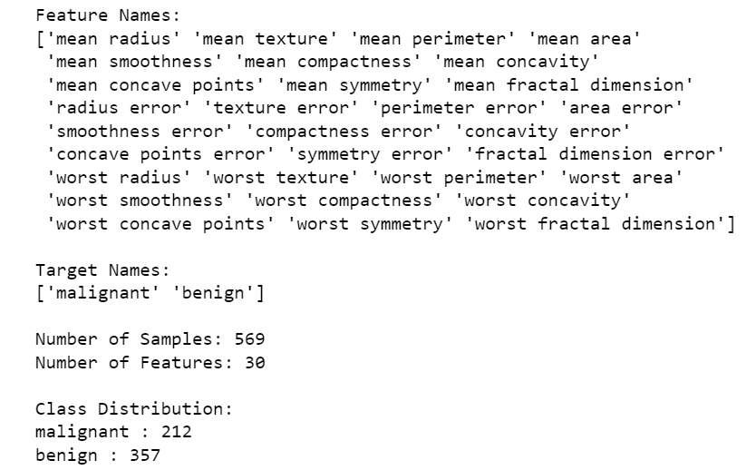
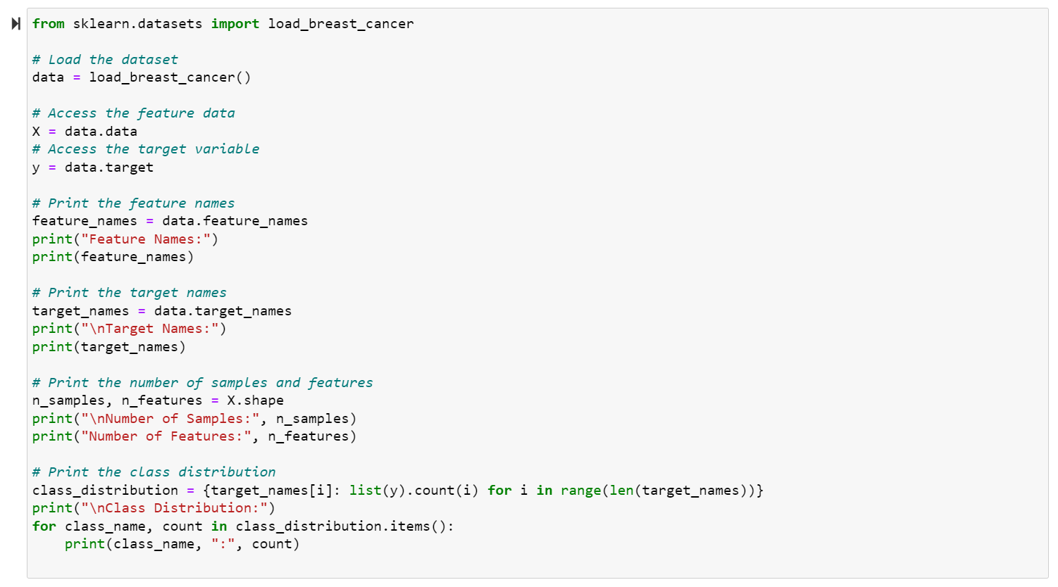
The Breast Cancer Wisconsin (Diagnostic) dataset

Slide 29
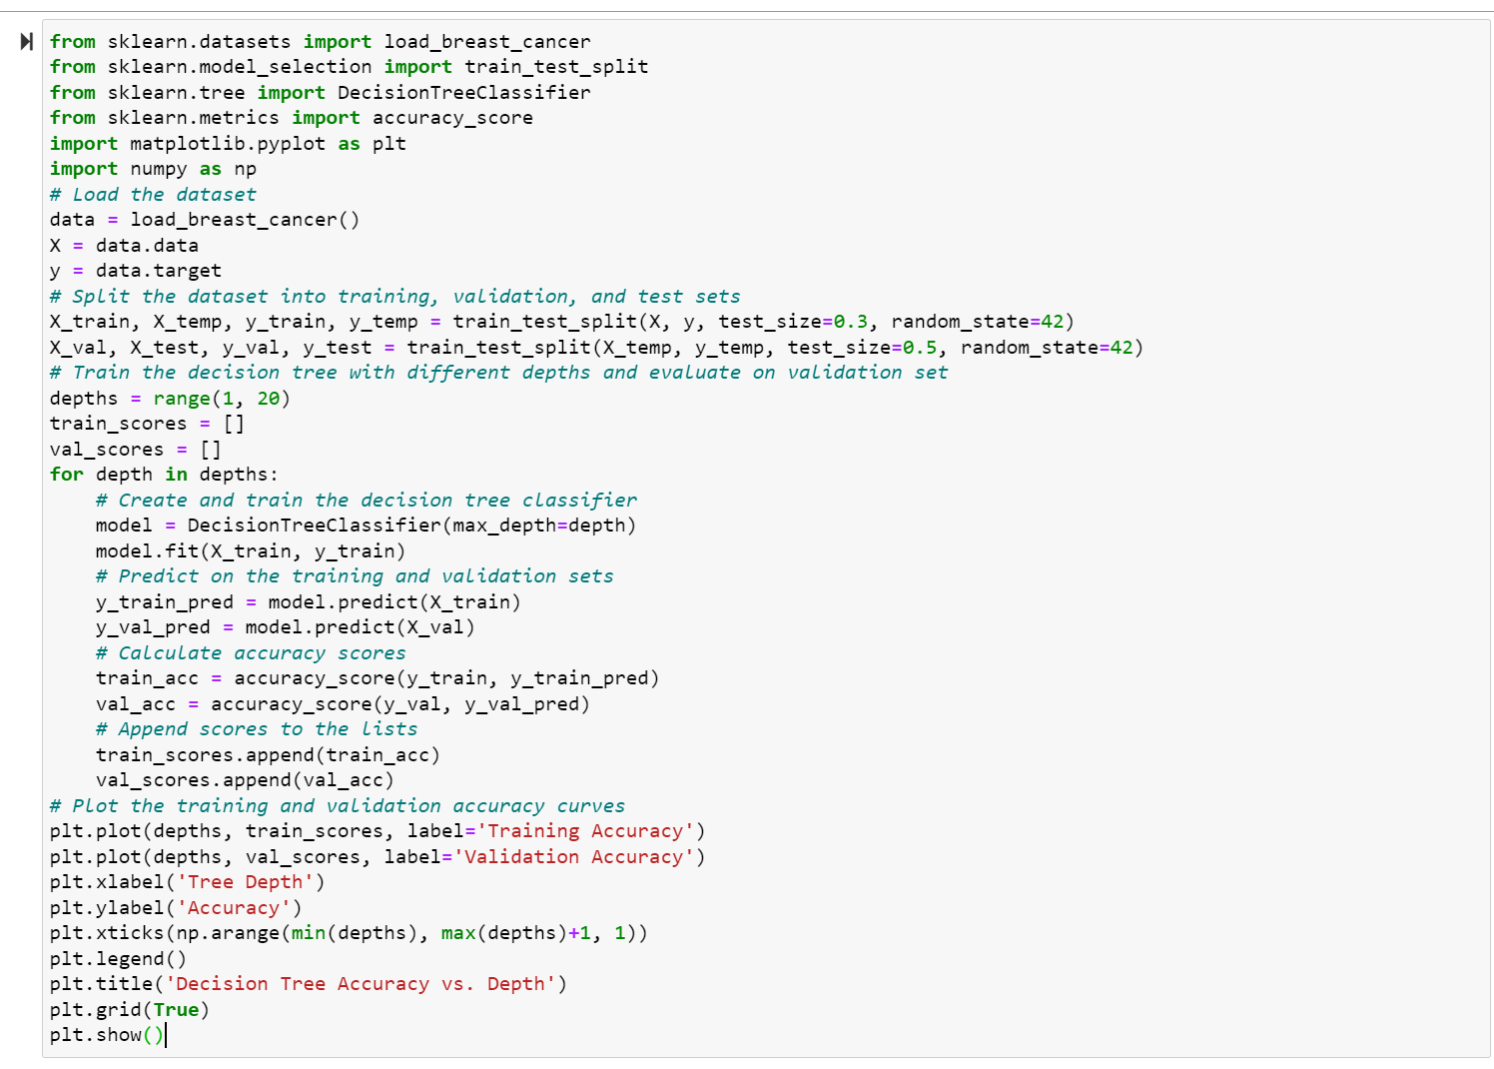
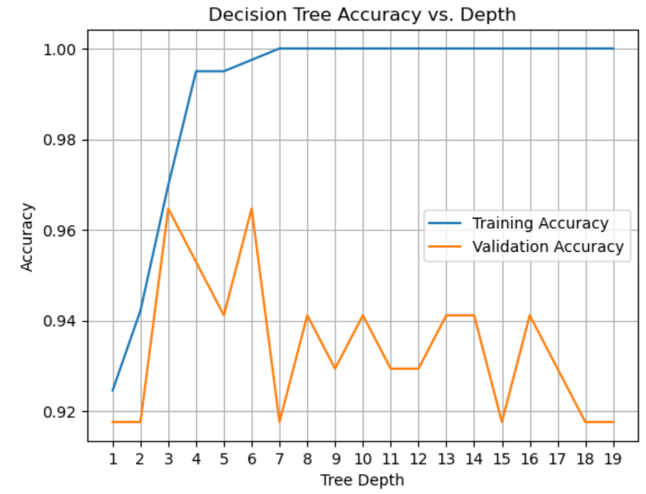
Tunning Hyperparameters on Validation set:

Slide 30
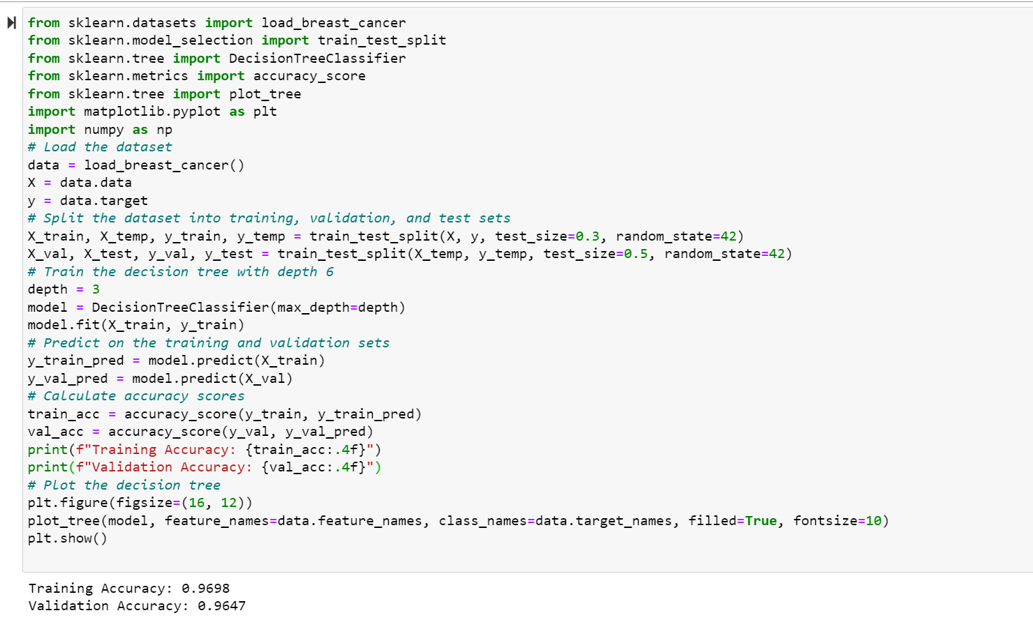
Training-validation-test split- Decision Tree:

Slide 31
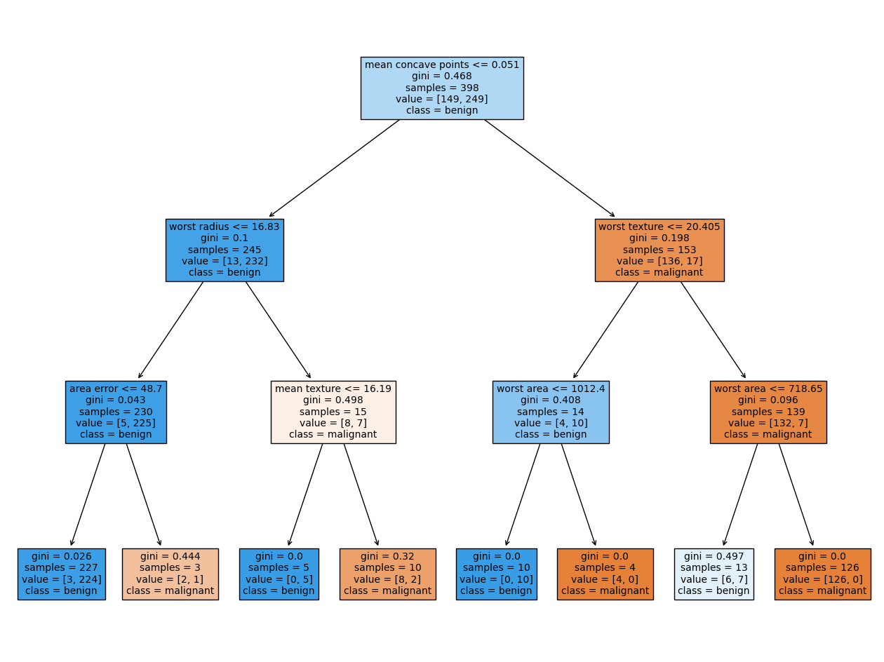

Slide 32
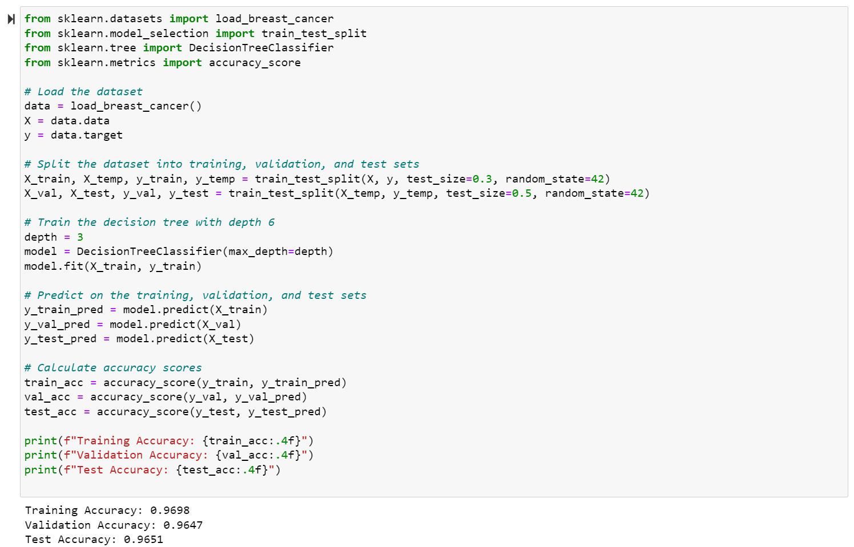
Training-validation-test split- Decision Tree:

Slide 33


AUC stands for Area Under the ROC Curve. It is a commonly used metric for evaluating the performance of binary classification models. The ROC curve (Receiver Operating Characteristic curve) is a graphical representation of the model's performance across various classification thresholds.

Slide 34
AUC is a good metric for several reasons:
It is insensitive to class imbalance: AUC is unaffected by the imbalance in the distribution of positive and negative examples in the dataset. This makes it a suitable metric when dealing with imbalanced datasets.
It is robust to changes in the decision threshold: AUC measures the model's performance across all possible decision thresholds, making it less sensitive to the specific threshold chosen for classification.
It measures the overall ranking quality: AUC takes into account the model's ability to correctly rank examples, rather than just the accuracy of individual predictions. It provides a holistic view of the model's discriminatory power.

Slide 35



Cross-validation:
https://commons.wikimedia.org/wiki/File:KfoldCV.gif

Slide 36


The Iris dataset:
Used for classification tasks and benchmarking different algorithms.
Contains measurements of four features of Iris flowers: sepal length, sepal width, petal length, and petal width.
Consists of three different species of Iris flowers: setosa, versicolor, and virginica.
Each species has 50 samples, making a total of 150 samples in the dataset.
Each sample is represented by a row of data with the four feature measurements.
Goal is typically to classify or predict the species of an Iris flower based on its feature measurements.

Slide 37


Support Vector Machines (SVM):
SVM aims to find the best hyperplane that separates the data points of different classes with the largest possible margin.
It is a binary classification algorithm but can be extended to handle multi-class classification problems.
SVM works by mapping the input data into a higher-dimensional feature space and finding an optimal hyperplane that maximally separates the classes.
The points closest to the hyperplane are called support vectors, which are crucial in defining the decision boundary.
SVM can handle both linearly separable and non-linearly separable data through the use of different kernel functions.
Common kernel functions include linear, polynomial, and radial basis function (RBF).
https://gfycat.com/gifs/search/svm
https://torchbearer.readthedocs.io/en/0.1.7/examples/svm_linear.html

Slide 38


SVM-OVO:

Slide 39



Slide 40



Slide 41

Rezapour M, Niazi MKK, Gurcan MN. Machine learning-based analytics of the impact of the Covid-19 pandemic on alcohol consumption habit changes among United States healthcare workers. Sci Rep. 2023 Apr 12;13(1):6003. doi: 10.1038/s41598-023-33222-y. Erratum in: Sci Rep. 2023 Apr 26;13(1):6818. PMID: 37046069; PMCID: PMC10092930.

Slide 43

Solving a Machine Learning problem

Slide 44

Problem: Predict the price of Houses

Slide 45
Sources of Data
Scraping from Internet Source
Sources of Data
Personal Databases
Publicly available repositories

Slide 46
Example: Overview of Housing Dataset
Consists of 14 features i.e., crime rate, proportion of businesses, distance to major centers, age.
Target Variable: median value of owner-occupied homes in $1000s.
Features | Description
ZN | proportion of residential land zoned for lots over 25,000 sq.ft.
INDUS | proportion of non-retail business acres per town
CHAS | Distance to Charles River
NOX | nitric oxides concentration
RM | average number of rooms per dwelling
AGE | proportion of owner-occupied units built prior to 1940

Slide 47
Dataset Features
Features | Description
DIS | weighted distances to ﬁve Boston employment centers
RAD | index of accessibility to radial highways
TAX | full-value property-tax rate per $10,000
PTRATIO | pupil-teacher ratio by town
LSTAT | lower status of the population
MEDV | Median value of owner-occupied homes in $1000s

Slide 48

Training, and Testing sets generation
Evaluation process that allows you to simulate how your model performs on new/unseen data.
Split ratio: 70:15:15.

Slide 49

Data Normalization
The attributes TAX, CRIM are generally considered as equally important, but their scales are different and TAX might take higher priority over other attributes

Slide 50




Importance of Data Normalization
Before Normalization
After Normalization
$$R_{12 }=31.0004$$
$$R_{13 }=12.0001$$
$$R_{12 }=1.024$$
$$R_{13 }=1.073$$

Slide 51


Data Normalization Methods
Min-max Normalization
Z-score Normalization

Slide 52

Min-Max Normalization

Slide 53
Data Cleaning
Remove the rows
Handling Missing Values
Imputation using Nearest Neighbors !
Mean, Median, Mode

Slide 54

Data Cleaning
Delete the Row!
Impute the missing values!

Slide 55

Data Cleaning

Slide 56


Pearson Correlation
Statistical tool that helps to measure the degree of relationship between two variables.
It deals with the association between two or more variables.

Slide 57

Correlation Matrix

Slide 58

Performance of Linear Regression on Validation set

Slide 59
Performance of Linear Regression on Test set

Slide 60
References
[1] https://developer.nvidia.com/blog/automatically-segmenting-brain-tumors-with-ai/
[2] https://www.educba.com/what-is-supervised-learning/
[3] https://mdpi.com/1424-8220/23/6/3080
[4] https://www.slideshare.net/dessybudiyanti/simple-linier-regression?from_action=save

